Slide 1
i ♥BLR
A Complete end to end website which gives a complete
information to someone who’s visiting Bangalore for the first time as well as those who visited before, as it covers very
special things to do and places to visit in Bangalore.
Joel Dsouza
Kiran S
Kishan KS

Slide 2
Contents Used:
HTML (Front End)
CSS (Front End)
Java Script (Front End)
React JS (Front End)
Node JS (Back End)
Mongo DB (Back End)
Express JS (Back End)

Slide 3
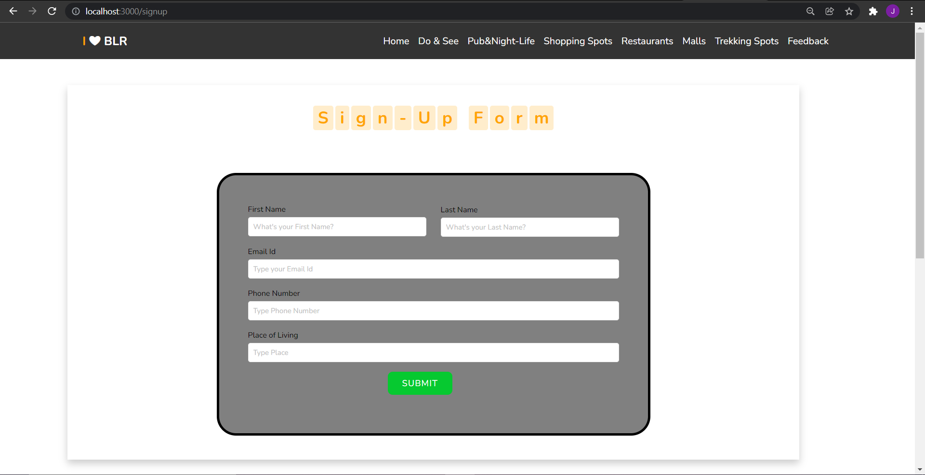
Authentication:
Users are given an option to Sign In or new users should Sign Up to view the content of the Site. Express JS and Mongo is used for this purpose.

Slide 4
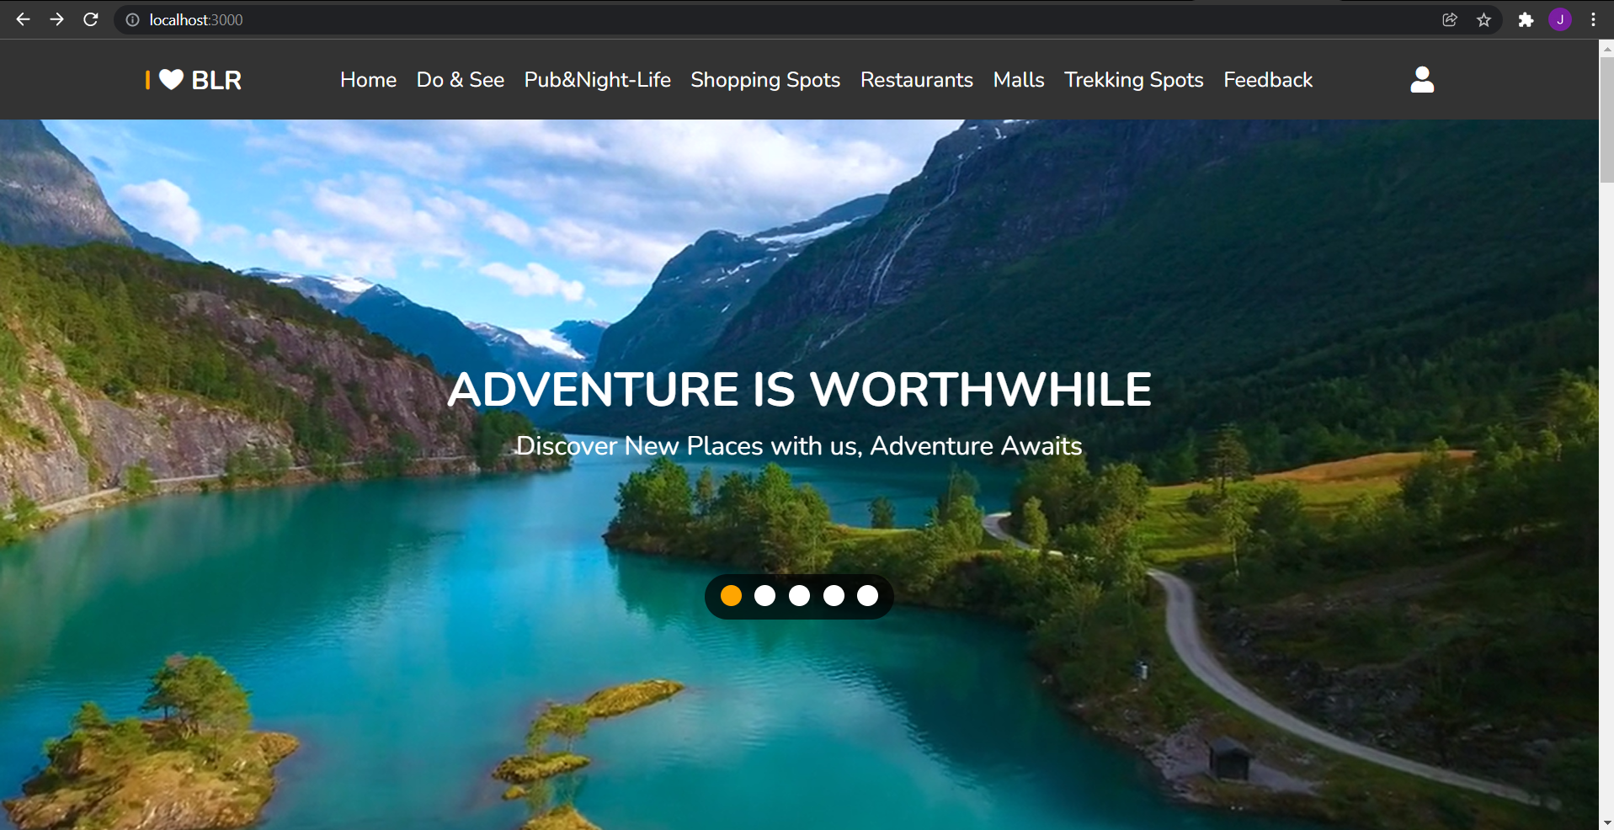
Home Page:
This page gives brief introduction about the contents of the site. Also some information about the city is also given to the users.

Slide 5
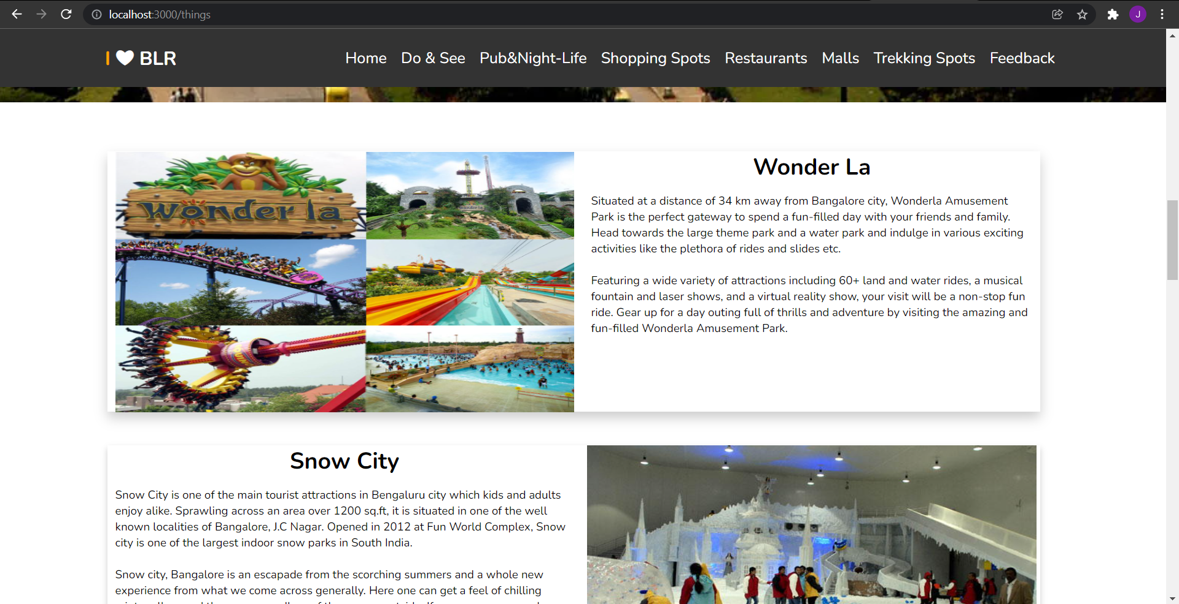
Information Page:
This page gives details of various places to visit, things to eat, eat, etc in Bangalore. Many different pages are included to give total information to the users.

Slide 6
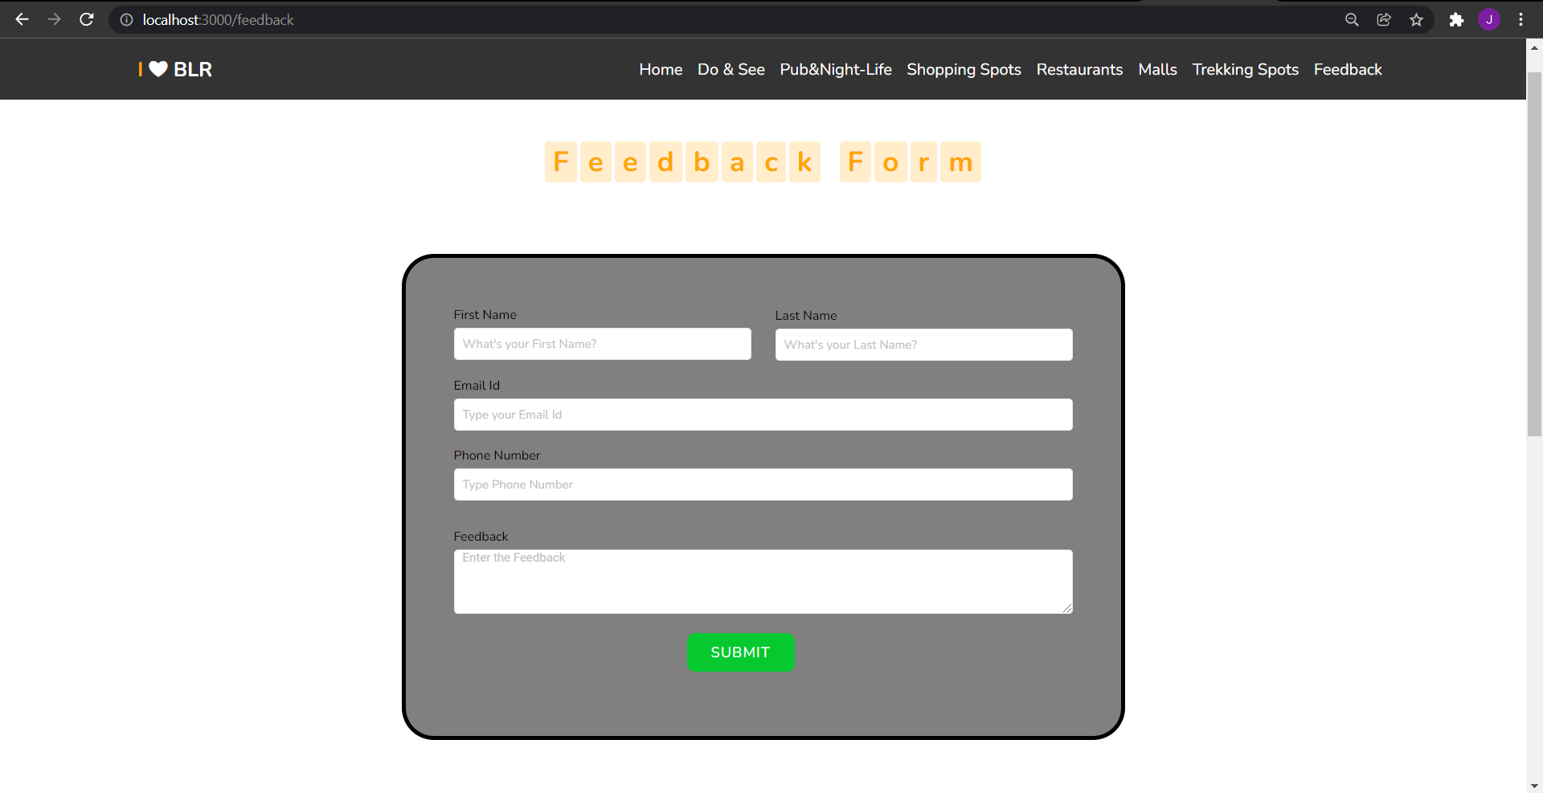
Feedback Form:
This page enables users to give their feedback about our website. They’ve to be registered to give their valuable feedback.

Slide 7
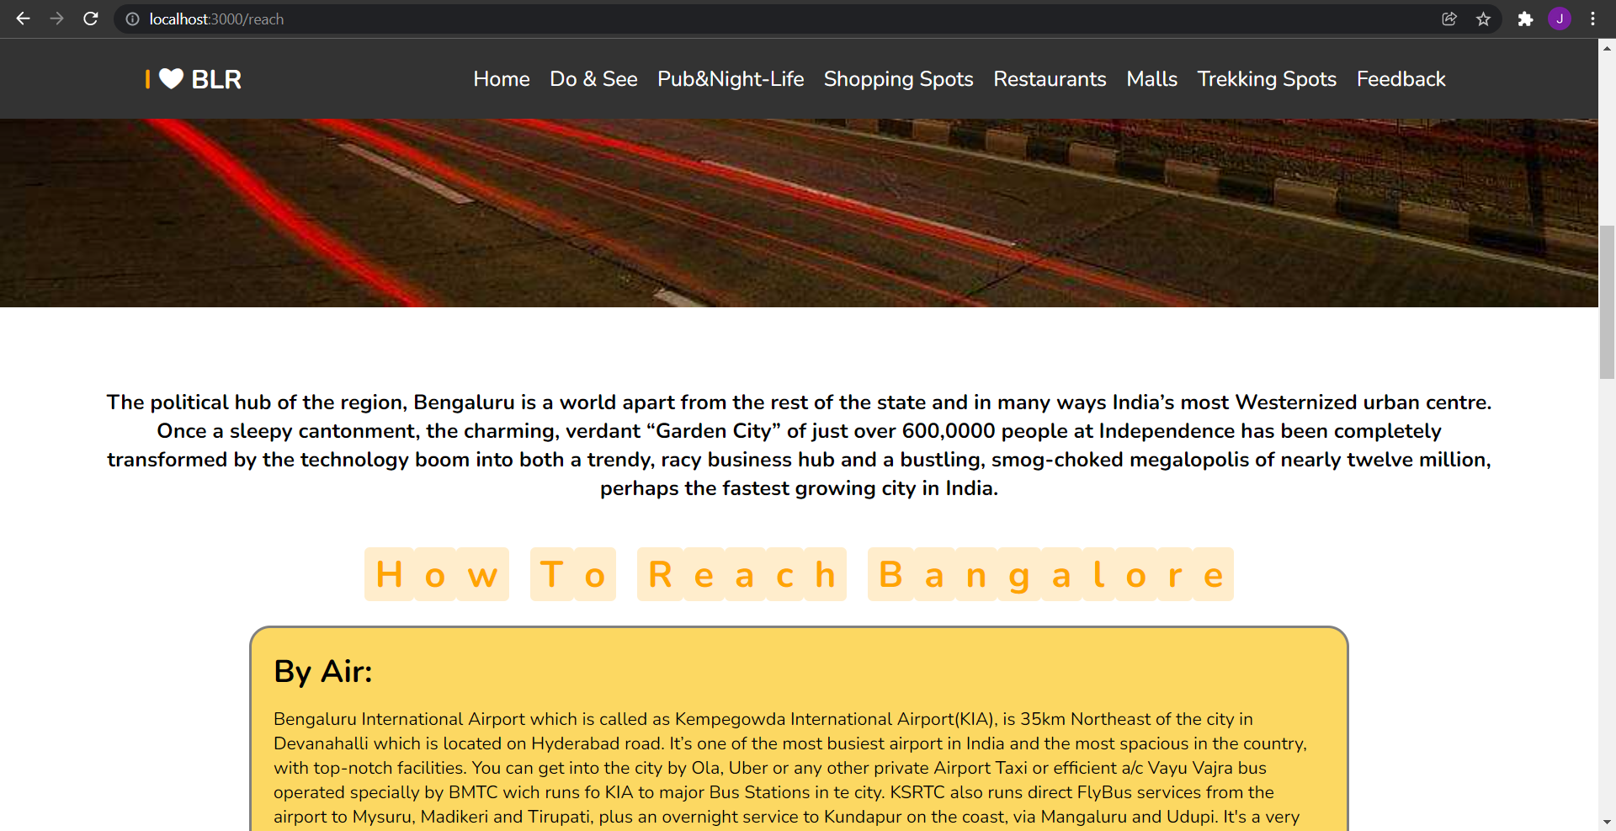
Other Info Page:
This helps users to make their work simple by giving them information about reaching Bangalore and moving around Bangalore.

